Slide 1
Python
the awesome programming language
Notes:
Hello everyone!

Slide 2
Python
created by Guido van Rossum
interpreted, interactive, object-oriented
easy to learn and powerful
Notes:
Η γλώσσα προγραμματισμού Python ξεκίνησε ως δημιουργία του Guido van Rossum στο τέλος της δεκαετίας του 80. Σήμερα αναπτύσσεται από μια μεγάλη και πολύμορφη κοινότητα προγραμματιστών. Η Python είναι μια εύκολη στην εκμάθηση και χρήση αλλά ταυτόχρονα πολύ δυνατή γλώσσα προγραμματισμού. Στο σχεδιασμό της κυριαρχεί ο στόχος για αναγνώσιμου και περιεκτικού κώδικα.

Slide 3
start here
http://www.python.org/

Slide 4
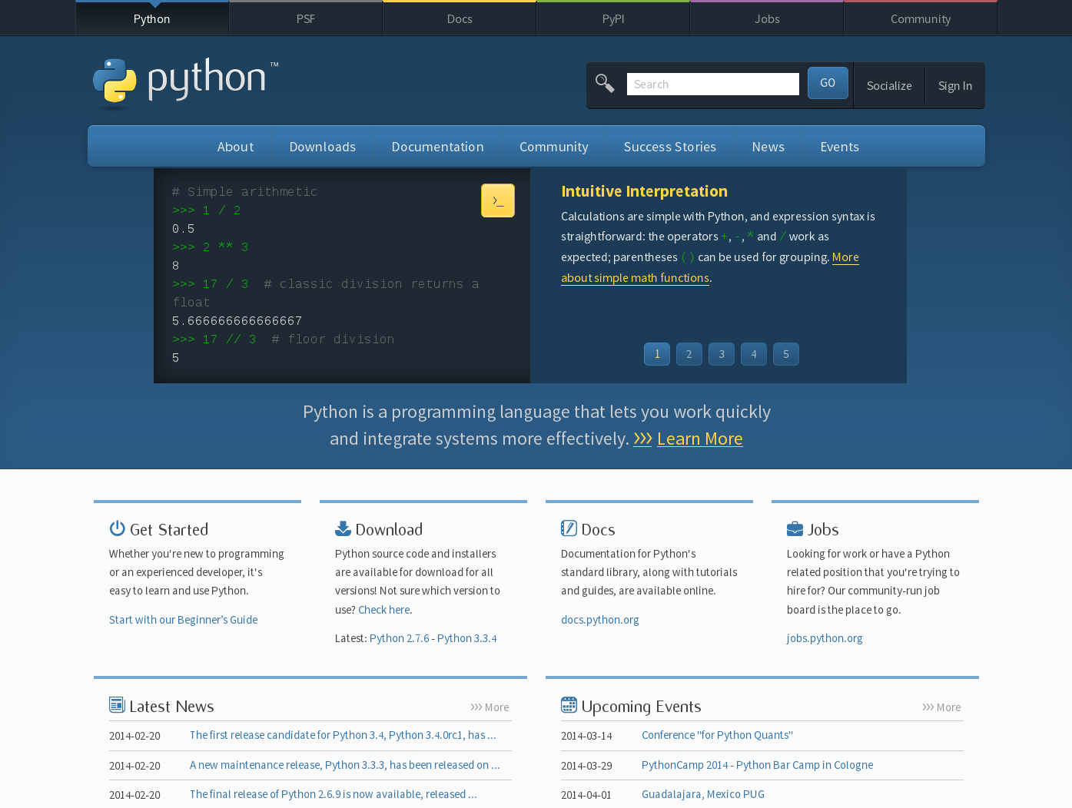

Slide 5

community
Notes:
a great community

Slide 6
documentation
http://www.python.org/doc/
Notes:
strong focus on quality documentation

Slide 7
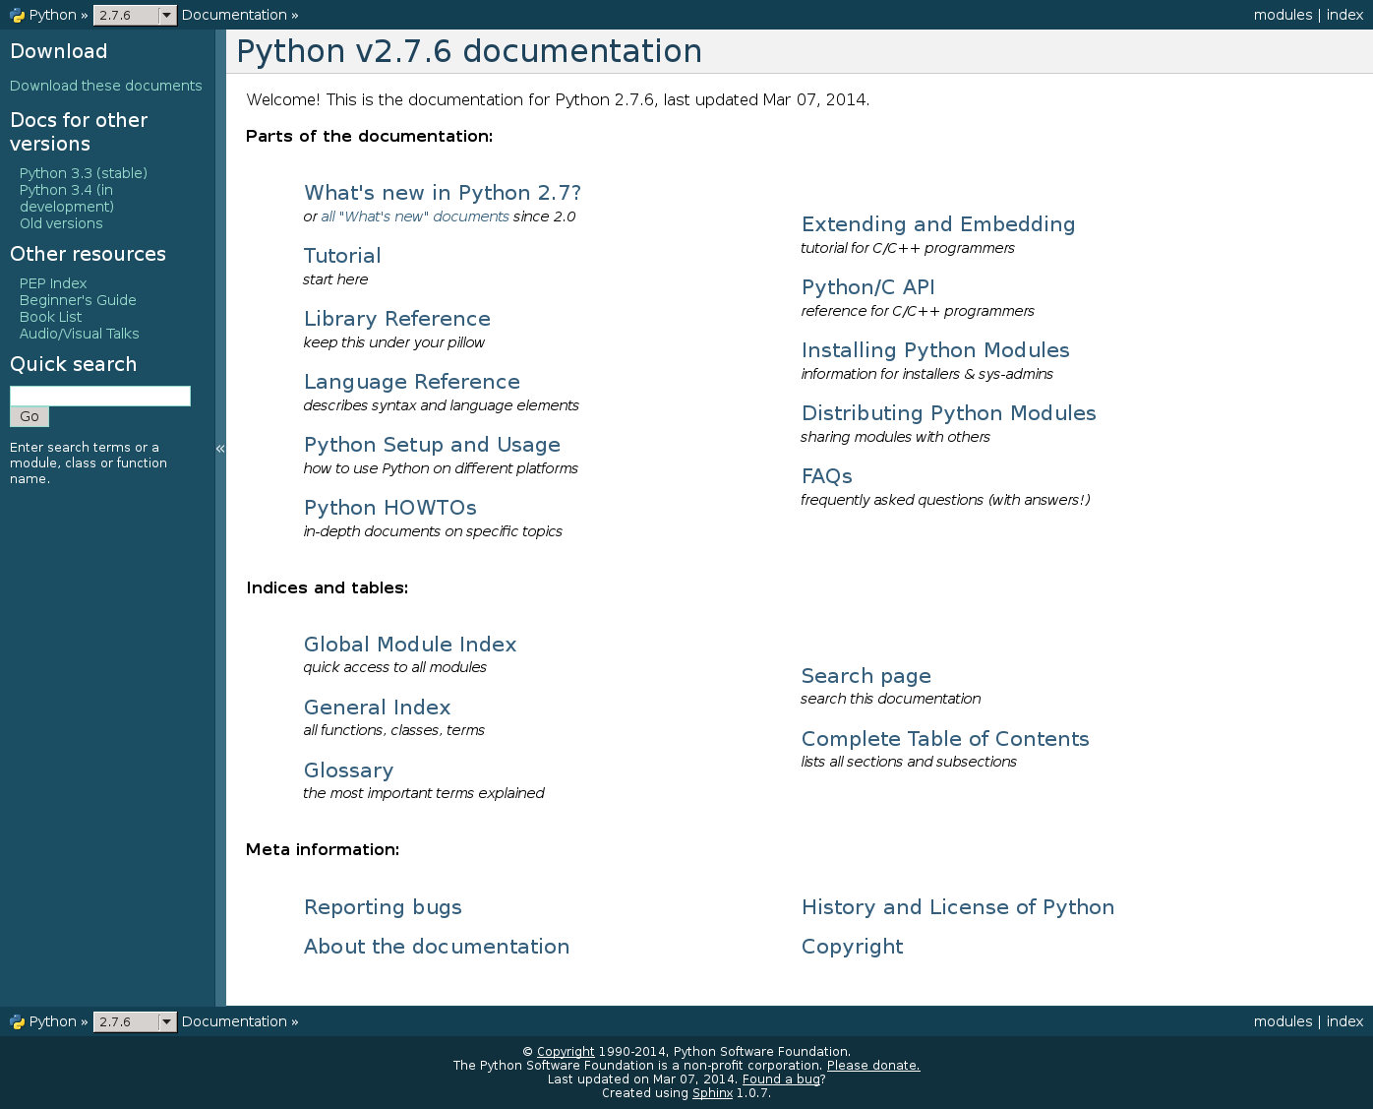

Slide 8
Stack Overflow
http://stackoverflow.com/questions/tagged/python

Slide 9
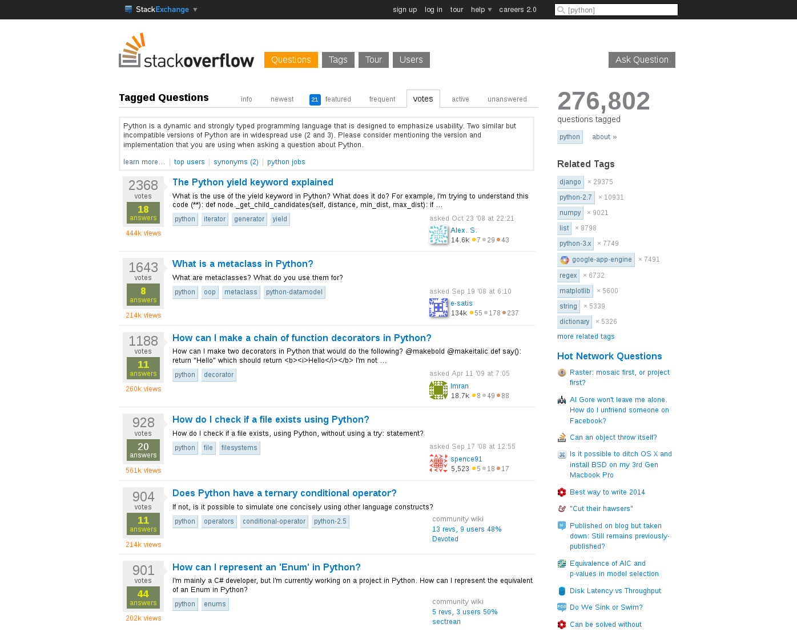

Slide 10
PyCon
http://www.pycon.org/

Slide 11
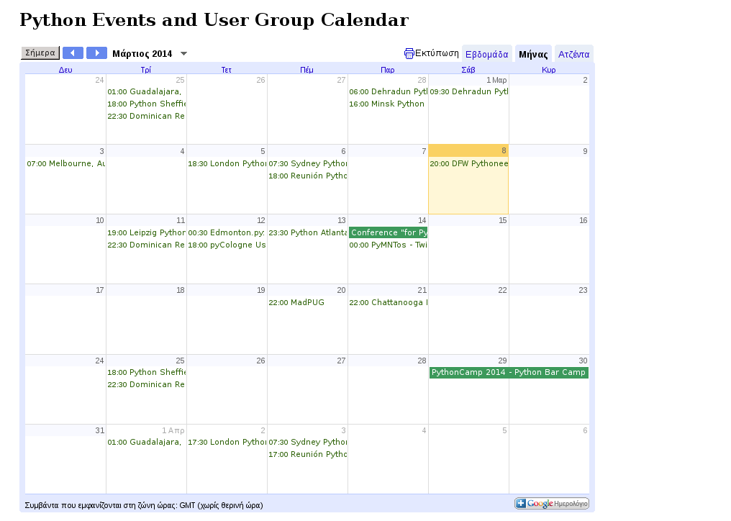

Slide 12
Python Software Foundation
"The mission of the Python Software Foundation is to promote, protect, and advance the Python programming language, and to support and facilitate the growth of a diverse and international community of Python programmers."
http://www.python.org/psf/

Slide 13
batteries included
http://docs.python.org/2/library/
http://docs.python.org/2/py-modindex.html
Notes:
an extensive standard library

Slide 14
modules
standing on the shoulders of giants
https://pypi.python.org/pypi?:action=browse

Slide 15
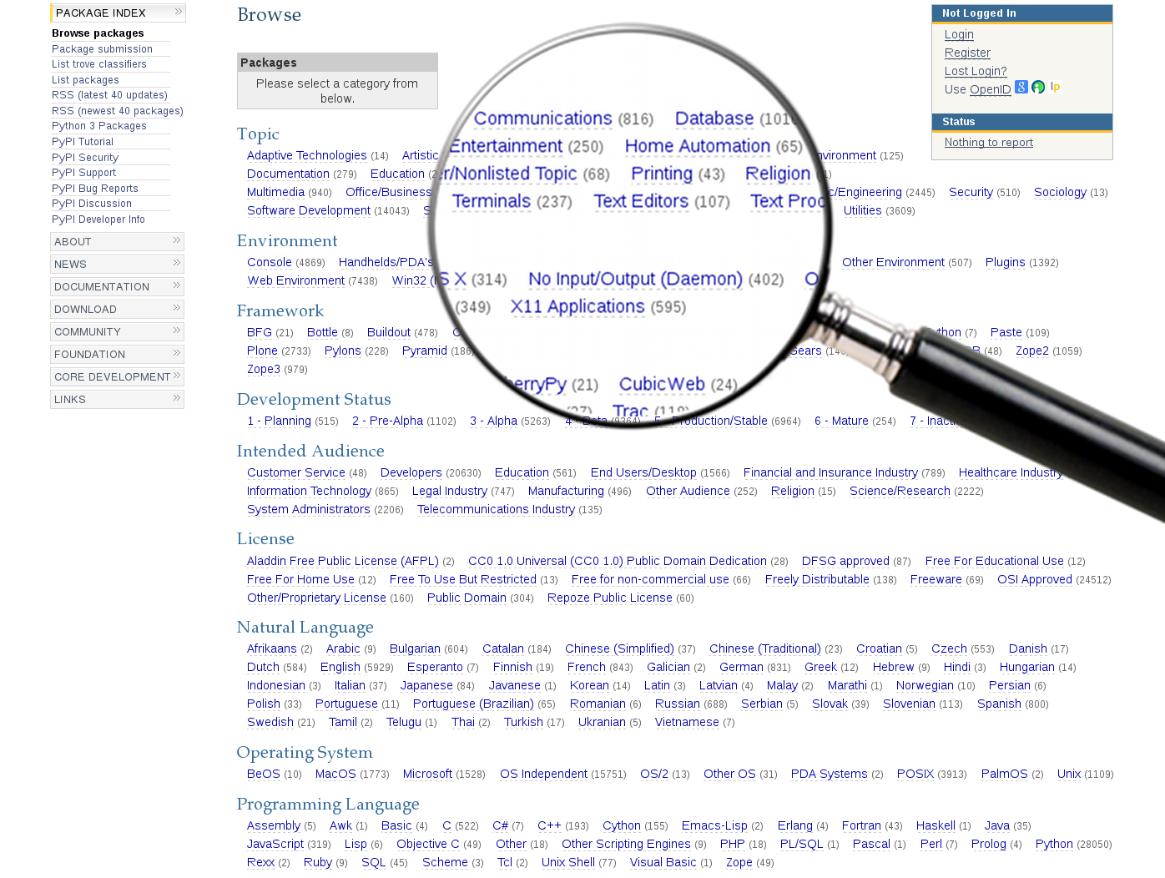
Notes:
a vast number of third party reusable modules

Slide 16
popularity
Notes:
it isn't everything, but sometimes is indicative and usually helps

Slide 17
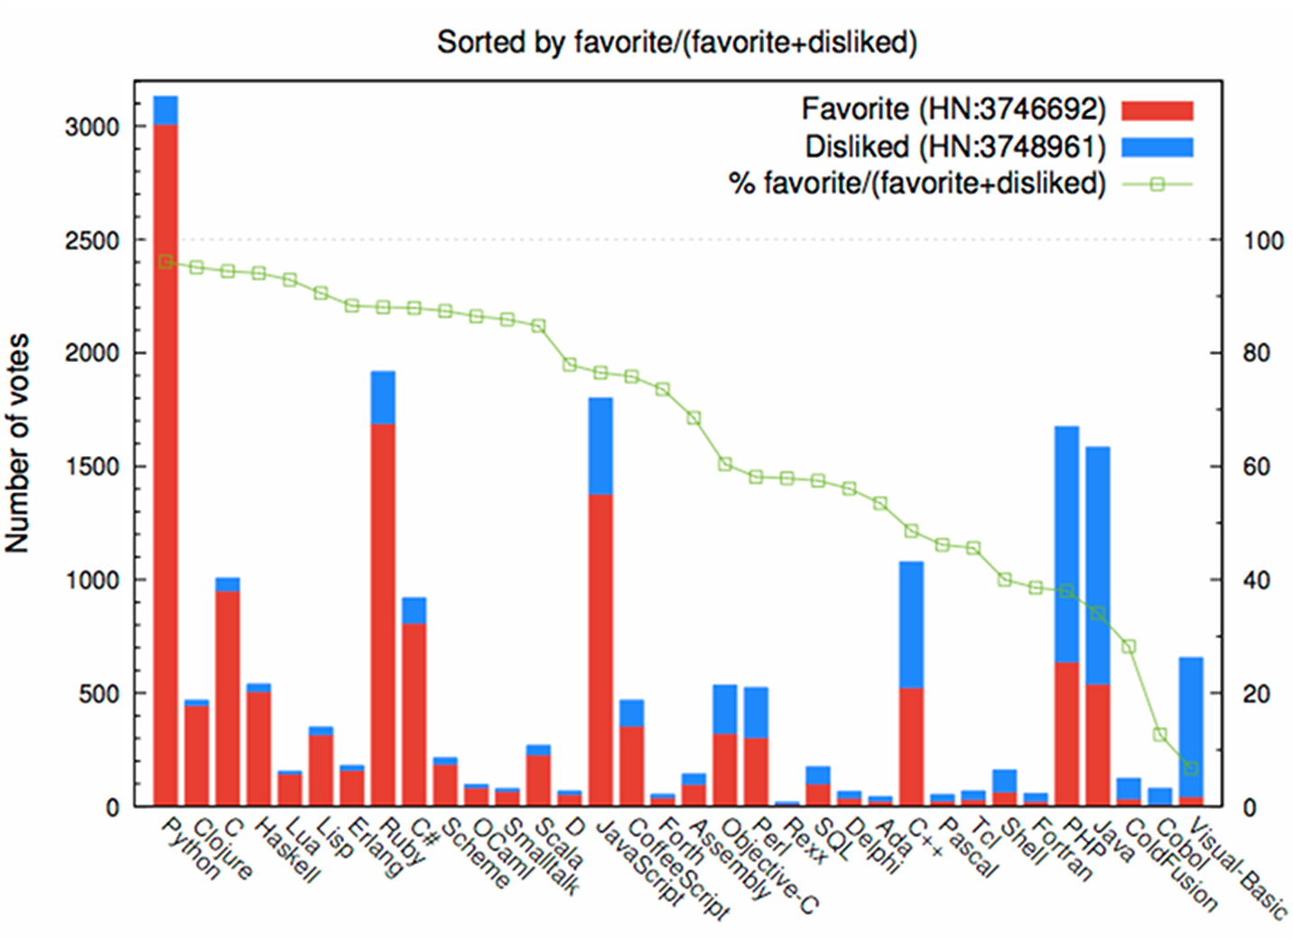
Notes:
both most favorite and less disliked

Slide 18
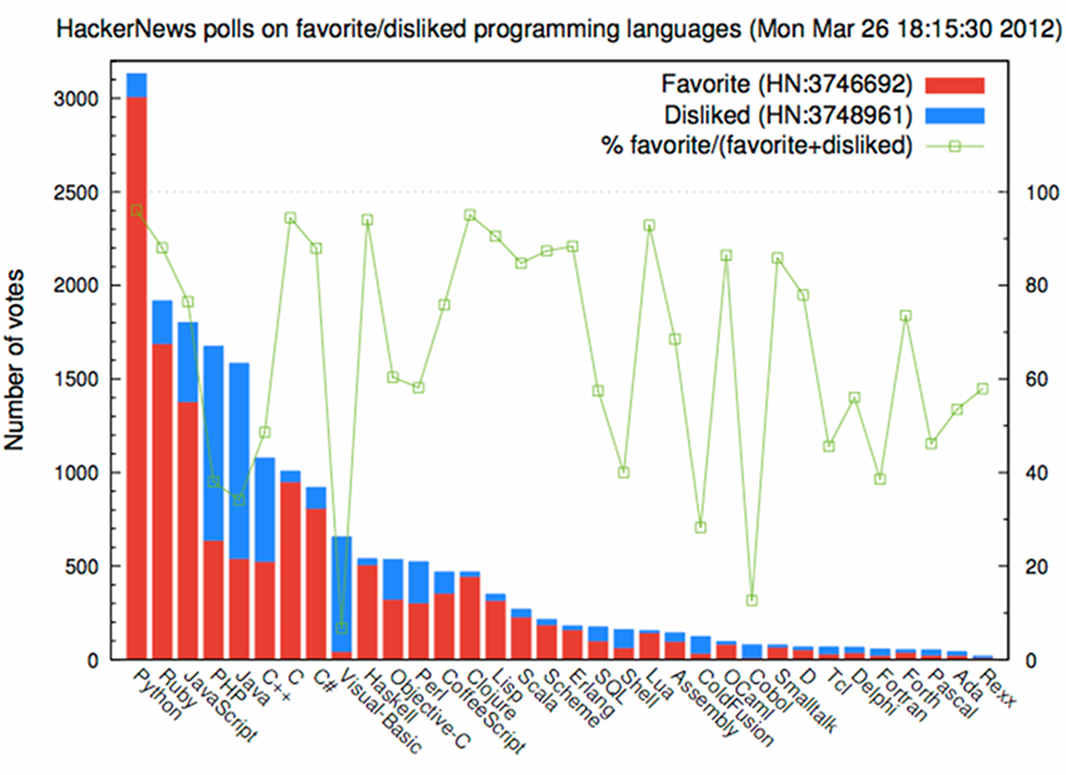
Notes:
a statistical outlier in dissemination and usage

Slide 19
syntax
elegant
readable
concise
print "Hello World!"

Slide 20
print the time
import datetime
print str(datetime.datetime.now())

Slide 21
Python 3
https://wiki.python.org/moin/Python2orPython3
Notes:
we'll focus on Python 2

Slide 22
variables
i = 5 # integer
f = 6.28 # float
s = "Hello World!" # string
u = "Καλημέρα!" # unicode
l = [0, 1, 1, 2, 3, 5, 8, 13, 21] # list
d = {'first': 1, 'second': 2, 'third': 3}
# dictionary
b = True # boolean
Notes:
γραμματοσειρά
κωδικοποίηση χαρακτήρων
http://docs.python.org/2/library/stdtypes.html

Slide 23
dynamic typing
no variable declaration
no variable initialization

Slide 24
dynamic typing
v = 5
print type(v)
<type 'int'>
v = v * 1.5
print type(v)
<type 'float'>
v = "Eve"
print type(v)
<type 'str'>

Slide 25
garbage collector
no memory management

Slide 26
OOP
Python is an object oriented
programming language
Notes:
objects
dot notation

Slide 27
string methods
s = "Hello World!"
print s.upper()
HELLO WORLD!
print s.lower()
hello world!
print s.find("o")
4
print s.replace("World", "everyone")
Hello everyone!
Notes:
http://docs.python.org/2/library/stdtypes.html#string-methods

Slide 28
data structures
"Languages shape the way we think, or don't."
Notes:
advanced data structures

Slide 29
list methods
l = [0, 1, 1, 2, 3, 5, 8, 13, 21]
l.append(34)
print l
[0, 1, 1, 2, 3, 5, 8, 13, 21, 34]
print l.pop()
34
print l.pop()
21
print l
[0, 1, 1, 2, 3, 5, 8, 13]
Notes:
http://docs.python.org/2/tutorial/datastructures.html#more-on-lists

Slide 30
more list methods
l = [0, 1, 1, 2, 3, 5, 8, 13, 21]
l.reverse()
print l
[21, 13, 8, 5, 3, 2, 1, 1, 0]
l = [10, 5, 1, 3, 2, 4, 9, 8, 7, 6]
l.sort()
print l
[1, 2, 3, 4, 5, 6, 7, 8, 9, 10]
Notes:
http://docs.python.org/2/tutorial/datastructures.html#more-on-lists

Slide 31
list element referencing
l = [1, 2, 3, 4, 5, 6, 7, 8, 9, 10]
print l[0], '+', l[1], '=', l[2]
1 + 2 = 3
print l[-1]
10
# +---+---+---+---+
# | l | i | s | t |
# +---+---+---+---+
# 0 1 2 3 4
# -4 -3 -2 -1
Notes:
http://docs.python.org/2/tutorial/datastructures.html#more-on-lists
http://docs.python.org/2/tutorial/introduction.html#lists

Slide 32
list slicing
l = [1, 2, 3, 4, 5, 6, 7, 8, 9, 10]
print l[0:5] # list[start:end]
[1, 2, 3, 4, 5]
print l[0:-5]
[1, 2, 3, 4, 5]
print l[1:-1]
[2, 3, 4, 5, 6, 7, 8,
print l[0:10:2] # list[start:end:step]
[1, 3, 5, 7, 9]
Notes:
http://docs.python.org/2/tutorial/datastructures.html#more-on-lists
http://docs.python.org/2/tutorial/introduction.html#lists

Slide 33
dictionary methods
d = {'a': 1, 'b': 2, 'c': 3, 'd': 4}
print d['a']
1
d['e'] = 5
print d['e']
5
print d.keys()
['a', 'c', 'b', 'e', 'd']
print d.values()
[1, 3, 2, 5, 4]
Notes:
http://docs.python.org/2/tutorial/datastructures.html#dictionaries
http://docs.python.org/2/library/stdtypes.html#mapping-types-dict

Slide 34
if, elif, else
a, b = 1, 2
if a < b:
print "a is less than b"
elif a > b:
print "a is greater than b"
else:
print "a and b are equal"
a is less than b
Notes:
control flow

Slide 35
while
while True:
print "Help! I'm stuck in a loop!"
temperature = 85
while temperature > 45:
print temperature
temperature -= 1
print "The tea is now cool enough."
Notes:
control flow

Slide 36
for
for item in iterable_collection:
# do something with item
for i in range(len(seq)):
# do something with seq[i]
string = "Hello World!"
for x in string:
print x
list_of_lists = [ [1, 2, 3], [4, 5, 6], [7, 8, 9]]
for list in list_of_lists:
for x in list:
print x
Notes:
control flow

Slide 37
list comprehensions
squares = []
for x in range(10):
squares.append(x**2)
print squares
[0, 1, 4, 9, 16, 25, 36, 49, 64, 81]
# equivalent to
squares = [x**2 for x in range(10)]
# syntax
la = [expression for item in list if conditional]
Notes:
http://docs.python.org/2/tutorial/datastructures.html#list-comprehensions

Slide 38
functions
def get_max(a, b):
"""
a and b are integers or floats
"""
if a > b:
return a
else:
return b
print get_max(1, 2)
2
print get_max(199, -54)
199

Slide 39
more functions
from __future__ import division
def get_average(i):
"""
i is an iterable collection containing numbers
"""
return sum(i) / len(i)
print get_average( [1, 2, 3, 4] )
2.5
print get_average( [0, 100] )
50.0

Slide 40
input
name = raw_input("What's your name? ")
print name
cost = input("How much is it? ")
pocket = input("How much do you have? ")
if cost > pocket:
print "I'm sorry but you can't afford it."
else:
print "Nice doing business with you."

Slide 41
output
print "\tHello everyone!\n"
Hello everyone!
print # print an empty line
s = "I am a string."
print s + " I really am.\n" # concatenate strings
I am a string. I really am.
print "%s Again." % s
I am a string. Again.

Slide 42
file operations
echo "Creating a text file." > text_file.txt
f = open("text_file.txt", "r") # read only
print f.read()
Creating a text file.
f = open("hello.txt", "w+") # create if missing
f.write("Hello World! ")
f.close()
f = open("hello.txt", "a") # append to the file
f.write("Hello again!\n")
f.close()
cat hello.txt
Hello World! Hello again!

Slide 43
using modules
import datetime
from __future__ import division
import numpy as np

Slide 44
Flask
pip install Flask
from flask import Flask
app = Flask(__name__)
@app.route("/")
def hello():
return "Hello World!"
if __name__ == "__main__":
app.run()
python server.py
* Running on http://localhost:5000/

Slide 45
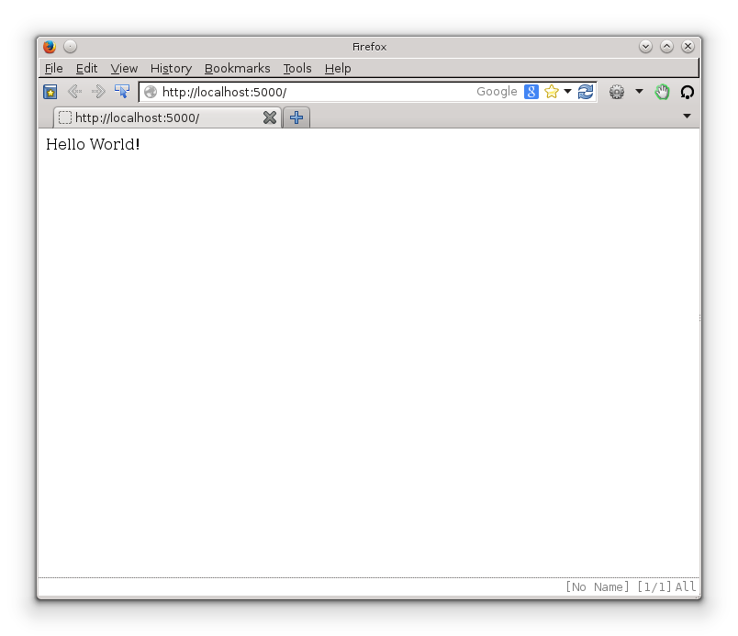

Slide 46
matplotlib
import numpy as np
import matplotlib.pyplot as plt
x = np.linspace(0, 1)
y = np.sin(4 * np.pi * x) * np.exp(-5 * x)
plt.fill(x, y, 'r')
plt.grid(True)
plt.show()
Notes:
http://matplotlib.org/examples/lines_bars_and_markers/fill_demo.html

Slide 47
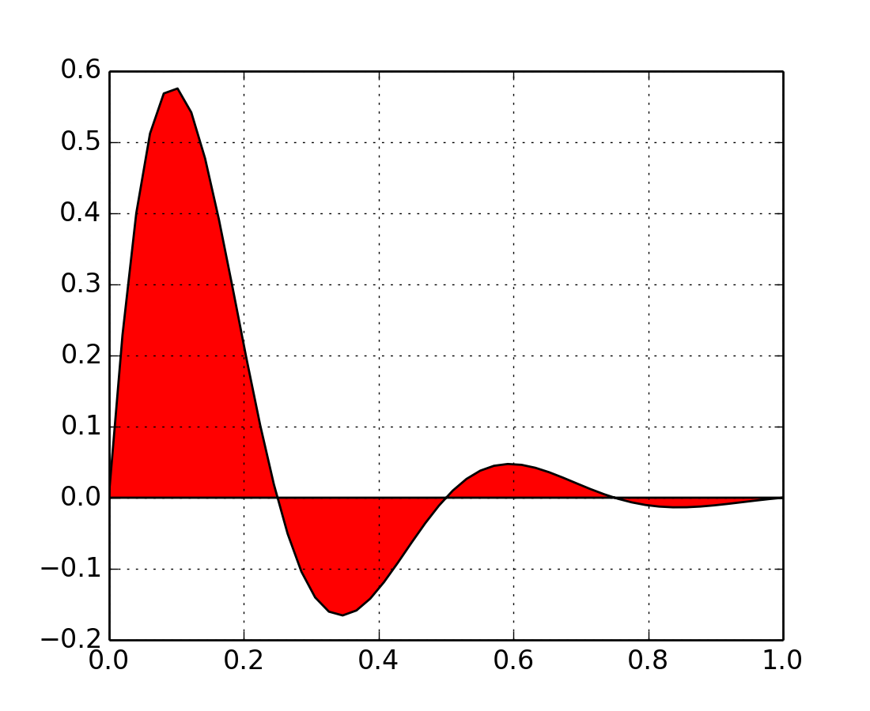

Slide 48
install
http://www.python.org/download/
Notes:
advanced data structures

Slide 49
editor
simple text editor
Vim for advanced usage
Notes:
advanced data structures

Slide 50
IDE
PyDev
http://pydev.org/
Notes:
advanced data structures

Slide 51
tools
IPython
Notes:
advanced data structures

Slide 52
resources
Python website
http://www.python.org/
documentation
http://docs.python.org/2/
Stack Overflow
http://stackoverflow.com/questions/tagged/python
Codecademy
http://www.codecademy.com/tracks/python
Think Python
http://www.greenteapress.com/thinkpython/
Dive Into Python
http://www.diveintopython.net/

Slide 53
Thank you!
@paraschas

Slide 54
Questions?

Slide 55
created for the hacker group of
the University of Thessaly, VolosHack
2014-03-08, Volos, Greece

